Slide 1
Happily together: F# and T-SQL
Dmitry Morozov, DMITRY SEVASTIANOV
AUGUST 26, 2014

Slide 2
Interesting facts from TIOBE Index
T-SQL – "Programming Language of the Year“ in 2013
The award is given to the programming language that has the highest rise in ratings in a year.
F# - as of today moved up 37 places since July 2013
Both are doing remarkably well

Slide 3

If both are so good LET’S JUST ADD them UP WHAT POSSIBLY CAN GO WRONG ?

Slide 4

The Vietnam of Computer Science

Slide 5
A less scary version

Slide 6
T-SQL DATA ACCESS OPTIONS for F# developers
 | Productivity | Types/IDE | Abstraction | Performance | Control
ADO.NET | NO | NO | NO | YES | YES
ORM - EF | - | - | - | NO | NO
Light ORM - Dapper | - | - | - | YES | YES
LINQ - SQLProvider | YES | YES | - | NO | NO

Slide 7
SqlCommandProvider Bridging the gap between F# types and T-SQL scripting

Slide 8
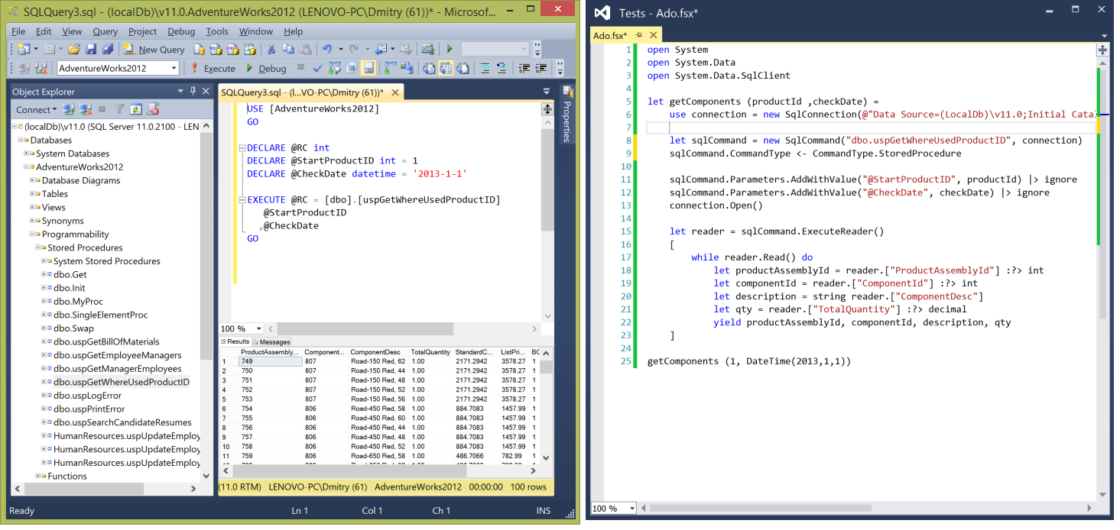
SqlProgrammabilityProvider Enterprise development with SQL

Slide 9
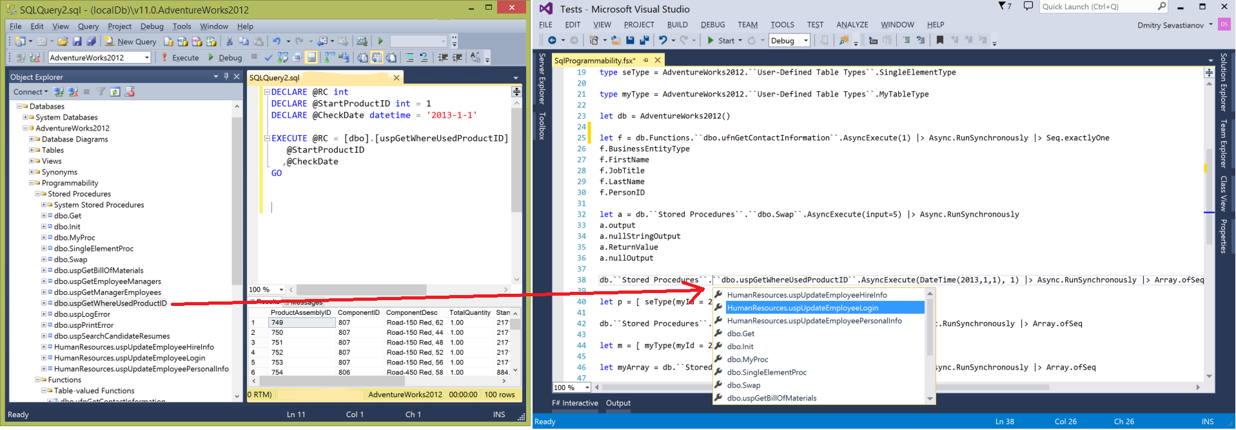
SqlProgrammabilityProvider SSMS Object Explorer with IntelliSense

Slide 10
SqlProgrammabilityProvider Features at glance
SSMS Object explorer in Visual Studio IntelliSense
Stored procedures, table-valued user-defined functions, user-defined table types
Microsoft.SqlServer.Types:
SqlHierarchyId
SqlGeography
SqlGeometry

Slide 11
SqlProgrammabilityProvider Summary
Connection string retrieval similar to SqlCommandProvider
Support for default parameters in Stored Procedures
Support for output parameters and ReturnValue in Stored Procedures
Support for User-Defined Table Types – both for Stored Procedures and Table-valued UDFs

Slide 12
Bonus - SqlEnumProvider

